Slide 1
Antitrust Policy Notice
RISC-V International meetings involve participation by industry competitors, and it is the intention of RISC-V International to conduct all its activities in accordance with applicable antitrust and competition laws. It is therefore extremely important that attendees adhere to meeting agendas, and be aware of, and not participate in, any activities that are prohibited under applicable US state, federal or foreign antitrust and competition laws.
Examples of types of actions that are prohibited at RISC-V International meetings and in connection with RISC-V International activities are described in the RISC-V International Regulations Article 7 available here: https://riscv.org/regulations/
If you have questions about these matters, please contact your company counsel.

Slide 2
Collaborative & Welcoming Community
RISC-V is a free and open ISA enabling a new era of processor innovation through open standard collaboration. Born in academia and research, RISC-V ISA delivers a new level of free, extensible software and hardware freedom on architecture, paving the way for the next 50 years of computing design and innovation.
We are a transparent, collaborative community where all are welcomed, and all members are encouraged to participate. We are a continuous improvement organization. If you see something that can be improved, please tell us. help@riscv.org
We as members, contributors, and leaders pledge to make participation in our community a harassment-free experience for everyone.
https://riscv.org/risc-v-international-community-code-of-conduct/

Slide 3
Conventions
Unless it is a scheduled agenda topic, we don’t solve problems or detailed topics in most meetings unless specified in the agenda because we don’t often have enough time to do so and it is more efficient to do so offline and/or in email. We identify items and send folks off to do the work and come back with solutions or proposals.
If some policy, org, extension, etc. can be doing things in a better way, help us make it better. Do not change or not abide by the item unillaterly. Instead let's work together to make it better.
Please conduct meetings that accommodates the virtual and broad geographical nature of our teams. This includes meeting times, repeating questions before you answer, at appropriate times polling attendees, guide people to interact in a way that has attendees taking turns speaking, …
Where appropriate and possible, meeting minutes will be added as speaker notes within the slides for the Agenda

Slide 4
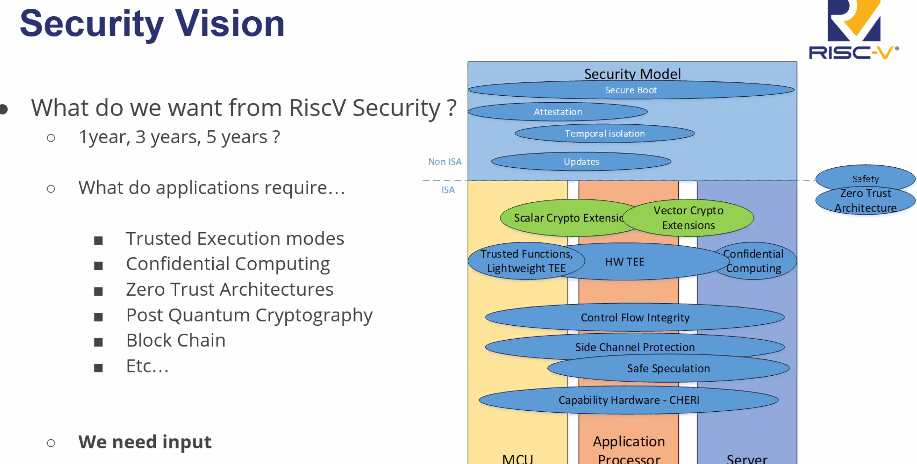

Slide 5
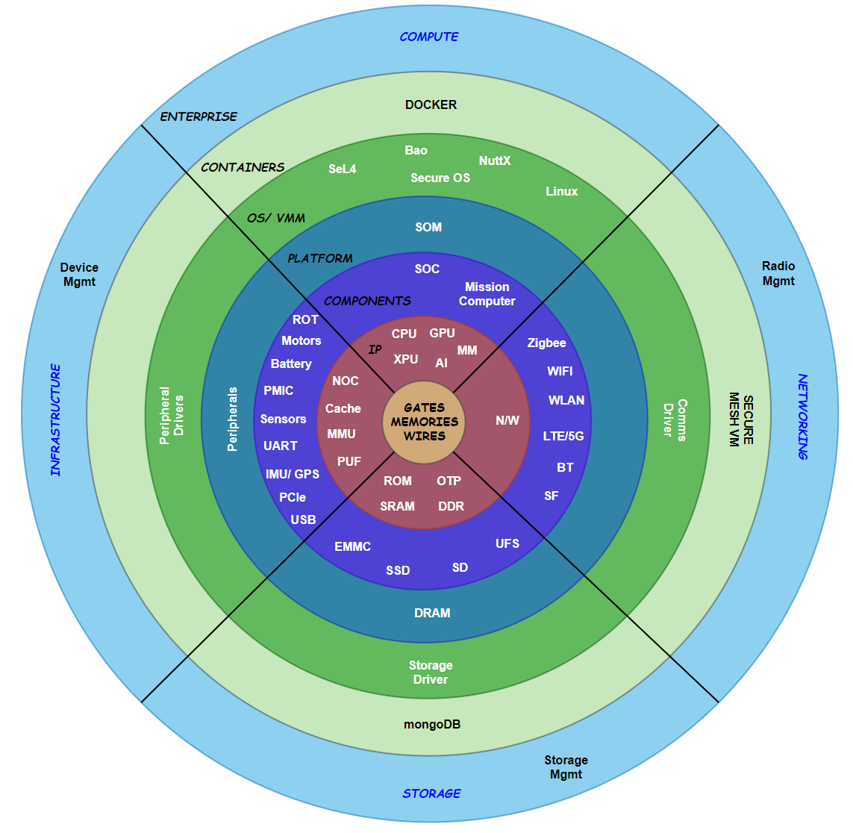
Potential Topics
Zero Trust Architecture (ZT)
Control Flow Integrity (CFI)
ROP, JOP, COP, Pointer Safety
Confidential Computing (CC)
Attestation, VMs, Realms, Enclaves
Capabilities Extension
CHERI, PIE
Safe Speculation
Spectre, Meltdown Safety, Cache Coloring
Side Channel Safety
Fence.t
Secure Boot/ RoT

Slide 6
SIG Renaming
Security Technologies
Exploratory Topics?
Zero Trust?
Open to suggestions…

Slide 7
Security HC
THIS SIG
Memory SIG
Crypto SIG
Blockchain SIG
ZT WG
CFI WG
Confidential Computing WG
Capabilities HW WG
Side Channel WG
ZT TG
CFI TG
Confidential Computing TG
Capabilities HW TG
Side Channel TG
WG – Working Group
TG – Task Group
Separate meetings with focus groups working on a topic.
HC approves TG when mature.

